Slide 1

Now Let’s

Slide 2

Visualization of data
Visualization of data
Quick How and When
Great resources

Slide 3
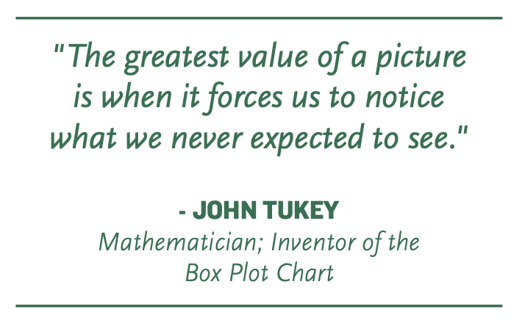

Slide 4
Let’s try an experiment. In the string of numbers below, count the number of times the number 4 appears.
756395068473 658663047576
860472658602 846589107840

Slide 5
Now, let’s try it again. Count the number of times the number 4 appears in the string of numbers below.
756395068473 658663047576
860472658602 846589107840

Slide 6
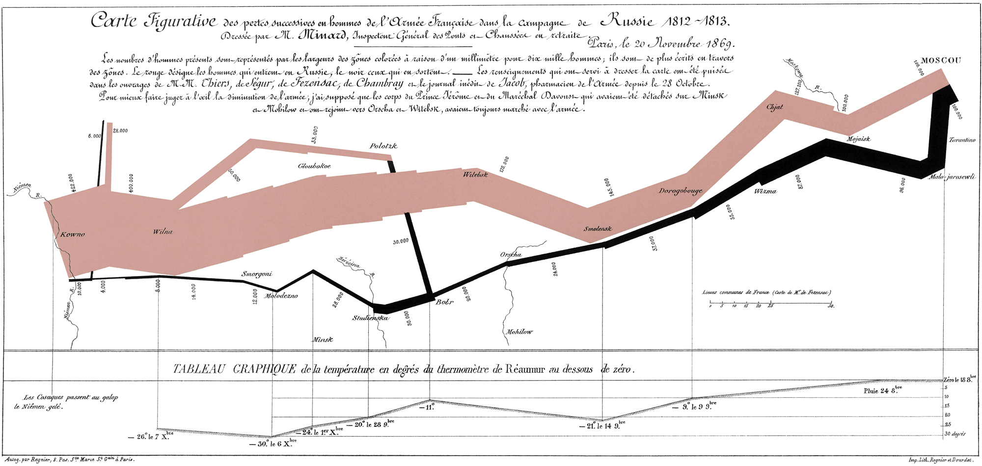
NAPOLEON’S Retreat from Moscow
Probably the best statistical graphic ever drawn, this map by Charles Joseph Minard portrays the losses suffered by Napoleon's army in the Russian campaign of 1812.
Notes:
https://www.edwardtufte.com/tufte/Minard
https://www.masswerk.at/minard/

Slide 7
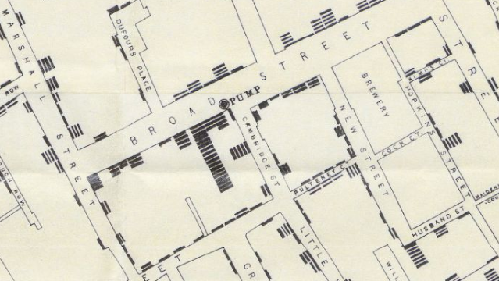
Data Visualization and Cholera 1854
In 1854, Dr. John Snow was convinced that cholera was spreading via tainted water and decided to display neighborhood mortality data directly on a map. This method clearly revealed a cluster of cases around a specific pump.
https://www.visualcapitalist.com/data-visualization-cholera/
Notes:
https://www.visualcapitalist.com/data-visualization-cholera/
https://www.theguardian.com/news/datablog/2013/mar/15/john-snow-cholera-map

Slide 8
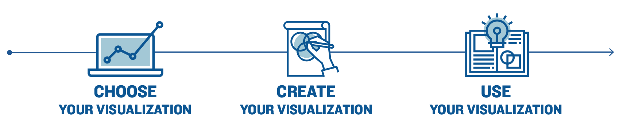
Steps for Choosing Your Visualization

Slide 9
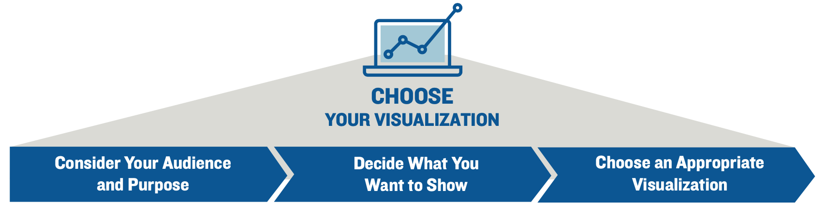

Slide 10
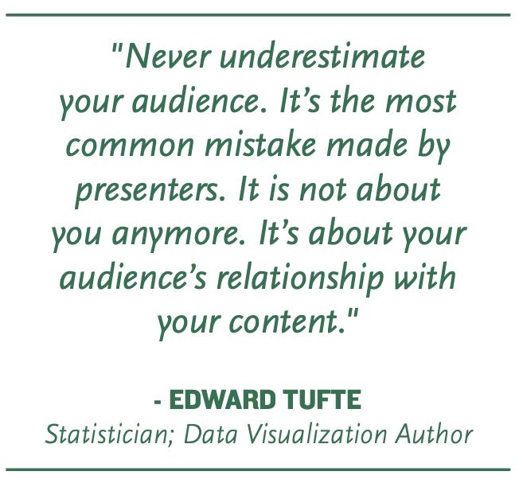
When considering the target audience of your visualization, there are multiple factors you should think about: their understanding of the context (as it relates to the data visualization), their baseline knowledge of the data used, and any analytic techniques used in the process. Understanding these factors will help you determine how specific to get and the level of detail you need to communicate.

Slide 11
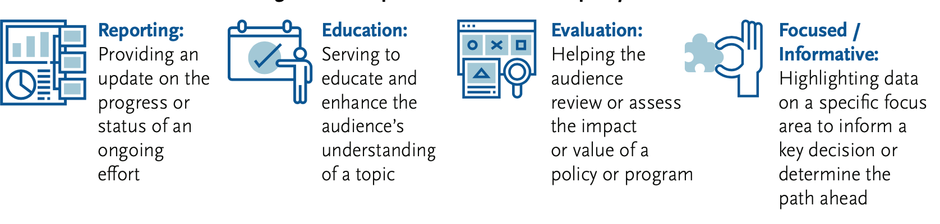
Consider the Purpose
Why you are telling them a story about your data? Do you want to give your supervisor an update about a program that your team is tracking? Do you want to help the audience better understand a topic or change their mind about it? Do you want to reinforce prevailing knowledge or introduce a new idea given your analysis? Ask yourself these types of questions, about the purpose of your visualization, as you choose the right one for your audience, your data, and your message. Some examples of the purpose or goal of your visualization include:

Slide 12

There are five main concepts or relationships a visualization can communicate:
Comparison: Shows the similarities or dissimilarities in your data
Distribution: Shows how your data is spread out
Composition(Part-to-Whole): Shows how your data is made up of smaller
parts and how they add up to make the whole data set
Correlation: Shows whether two datasets relate to each other and if they tend to move in the same or opposite directions
Process Flow: Shows the direction of movement and the steps in a process towards achieving an objective
Illustration of Comparison

Slide 13

There are five main concepts or relationships a visualization can communicate:
Comparison: Shows the similarities or dissimilarities in your data
Distribution: Shows how your data is spread out
Composition(Part-to-Whole): Shows how your data is made up of smaller
parts and how they add up to make the whole data set
Correlation: Shows whether two datasets relate to each other and if they tend to move in the same or opposite directions
Process Flow: Shows the direction of movement and the steps in a process towards achieving an objective
Illustration of Distribution

Slide 14

There are five main concepts or relationships a visualization can communicate:
Comparison: Shows the similarities or dissimilarities in your data
Distribution: Shows how your data is spread out
Composition(Part-to-Whole): Shows how your data is made up of smaller
parts and how they add up to make the whole data set
Correlation: Shows whether two datasets relate to each other and if they tend to move in the same or opposite directions
Process Flow: Shows the direction of movement and the steps in a process towards achieving an objective
Illustration of Composition

Slide 15
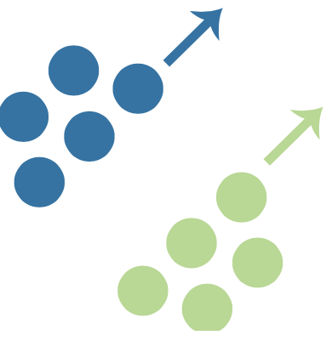
There are five main concepts or relationships a visualization can communicate:
Comparison: Shows the similarities or dissimilarities in your data
Distribution: Shows how your data is spread out
Composition(Part-to-Whole): Shows how your data is made up of smaller
parts and how they add up to make the whole data set
Correlation: Shows whether two datasets relate to each other and if they tend to move in the same or opposite directions
Process Flow: Shows the direction of movement and the steps in a process towards achieving an objective
Illustration of Correlation

Slide 16

There are five main concepts or relationships a visualization can communicate:
Comparison: Shows the similarities or dissimilarities in your data
Distribution: Shows how your data is spread out
Composition(Part-to-Whole): Shows how your data is made up of smaller
parts and how they add up to make the whole data set
Correlation: Shows whether two datasets relate to each other and if they tend to move in the same or opposite directions
Process Flow: Shows the direction of movement and the steps in a process towards achieving an objective
Illustration of Process Flow

Slide 17
There are five main concepts or relationships a visualization can communicate:
Comparison: Shows the similarities or dissimilarities in your data
Distribution: Shows how your data is spread out
Composition(Part-to-Whole): Shows how your data is made up of smaller
parts and how they add up to make the whole data set
Correlation: Shows whether two datasets relate to each other and if they tend to move in the same or opposite directions
Process Flow: Shows the direction of movement and the steps in a process towards achieving an objective
Illustration of Process Flow

Slide 18
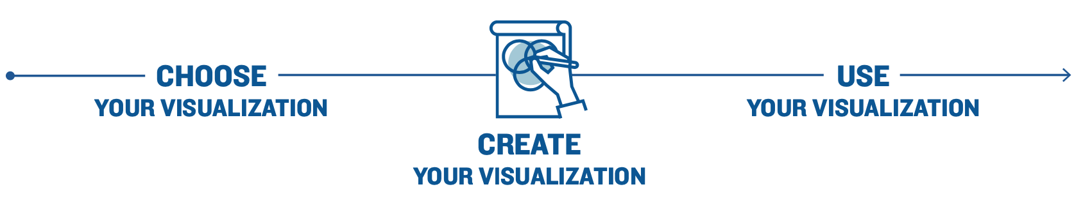
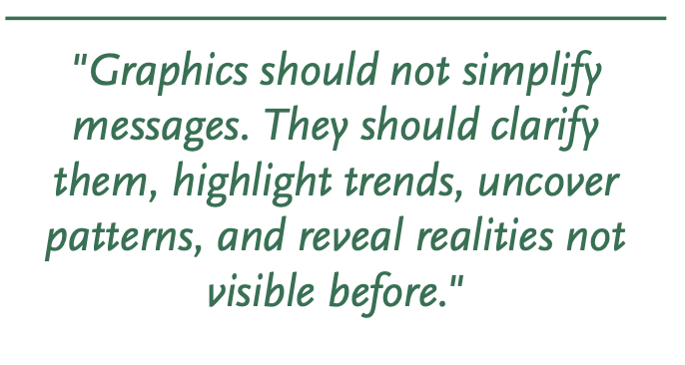
There is a Visualization Notebook in Blackboard under Course materials.
Each visualization tool often has a gallery of examples;
There are many great guides on the topic of visualization; there are links to some of the favorites at the top of the notebook.
visualization examples notebook

Slide 19
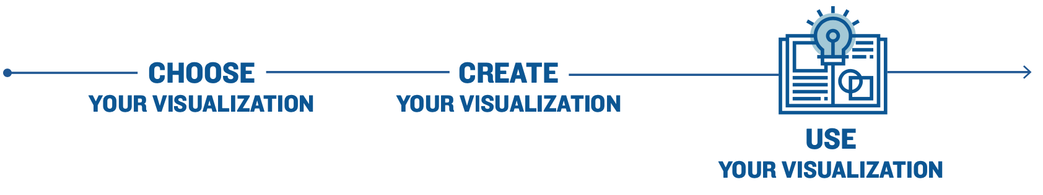
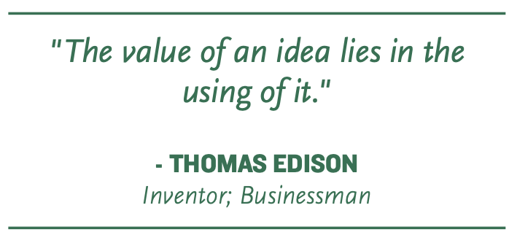
I Displayed My Data Visually, What Else Do I Need to Say?
Describes the problem or main question
Explains why the problem is important or how it is relevant to the audience
Highlights the key takeaways from your analysis (should reinforce the key takeaways already in your visualization)
Demonstrates how the key takeaways from the analysis either clarify the solution to the problem or are relevant to the problem
Presenting the Full Picture
Identify the problem or question
Put your visualization in a helpful place
Document your data
Show all relevant data
Provide comparisons as appropriate
Explain the cause and effect when appropriate
Acknowledge limitations in your data, analysis, or analytic techniques
Caveat your key takeaways

